Slide 1
Nexus between Oil Prices and Exchange Rates in the Context of Bangladesh
Presented By
ID: 17STA008
Year: 4th
Semester: 2nd
Session: 2017-18
Department of Statistics
Bangabandhu Sheikh Mujibur Rahman Science and Technology University

Slide 2
Project Outline
Introduction
Literature Review
Research Objectives
Methodology
Statistical Analysis and Research Results
Conclusion
Limitations of Study
Reference

Slide 3
Introduction
Nexus
Oil Prices
Exchange Rates
Background of the study
The relationship between crude oil price and the exchange rate
Limited research specifically focusing on the case of Bangladesh.

Slide 4
Research Objectives
1. We wish to show long-run relationships between oil price and exchange rate in Bangladesh
2. We wish to show causality between Crude Oil Price and Real Rate Of Exchange
3. Prediction of Crude Oil Price and Real Rate Of Exchange

Slide 5
Methodology
Unit Root Test
Tests for Cointegration
The Johansen cointegration test
Granger Causality
Autoregressive Moving Average
AIC and BIC

Slide 6
Statistical Analysis and Research Results
Figure: Real Rate of Exchange (RER) over Time

Slide 7
Figure : Crude Oil Price over Time

Slide 8
Figure : Consumer Price Index (CPI) over Time

Slide 9
Table : Stationary properties of the variable
Table reports the ADF and DF-GLS statistics for all the variables in their levels and first differenced forms. We reveal that the variables are non-stationary at the level, however, at the first difference for both constant and constant and trend configurations. So, our variables are integrated of order one.
DF
Variables | Level Intercept | First Difference Intercept
LNRER | 0.018320* | 0.207983
LNCPI | 0.03815** | 0.40090
LNCOP | -0.01695 | 0.01064
***,**, and *Refer significance level at 1, 5, and 10%, respectively. Critical values are not reported for the sake of brevity; however, it can be delivered on request

Slide 10
Table : Johansen cointegration test results
The Johansen Cointegration test reveals a cointegrating relationship among the variables in the Table. Both the Maximum Eigenvalue and the Trace test confirm that our variables have one cointegrating relationship.
 | Trace Test
Null | Alternative | Trace statistic | 10pct | 5pct | 1pct | Conclusion
r=0 | r=1 | 31.71 | 6.50 | 8.18 | 11.65 | There is cointegration
r<=1 | r=2 | 7.78 | 12.91 | 14.90 | 19.19 | There is no cointegration
r<=2 | r=3 | 0.25 | 18.90 | 21.07 | 25.75 | There is no cointegration

Slide 11
Table : Granger causality results
Table reveals a unidirectional causality from oil prices to the exchange rate in the long-run. No causal relationship is found in the longrun between the real exchange rate and CPI
Causality test statistics between LNRER and LNOP
Variable | Null Hypothesis | F static | P-value | Conclusion
LNRER | LNCOP does not cause LNRER | 0.0418 | 0.0393 | LNCOP does cause LNRER
LNCOP | LNRER does not cause LNCOP | 2.9113 | 0.09 | LNRER does not cause LNCOP
Causality test statistics between LNRER and LNCPI
Variable | Null Hypothesis | F static | P-value | Conclusion
LNRER | LNCPI does not cause LNRER | 0.168 | 0.6839 | LNCPI does not cause LNRER
LNCPI | LNRER does not cause LNCPI | 6.116 | 0.1889 | LNRER does not LNCPI

Slide 12
Table : AIC and BIC calculation
Table reavles AIC and BIC values of AR and MA model.As for AR model both AIC and BIC value is smaller than that of MA models AIC and BIC value we select AR model for forcusting RER and COP.
Model name | AIC | BIC
AR | 172.4539 | 190.7702
MA | 183.8238 | 202.1401

Slide 13
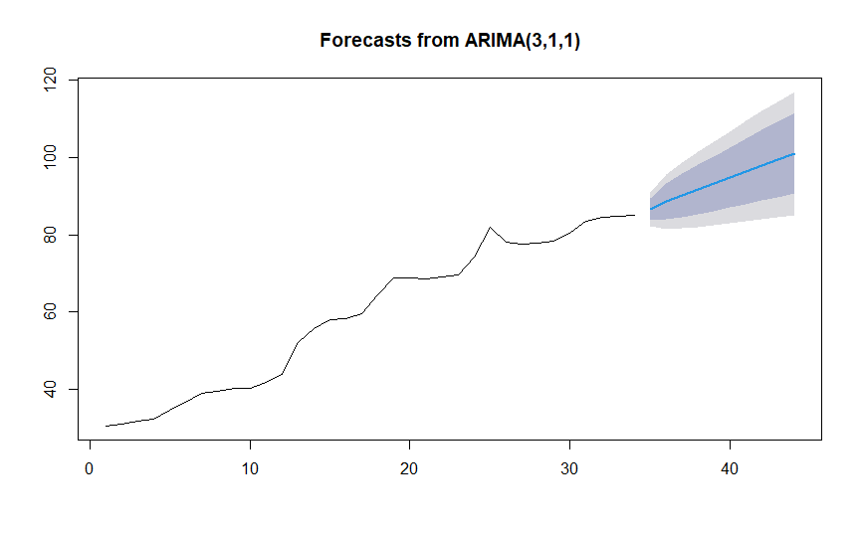
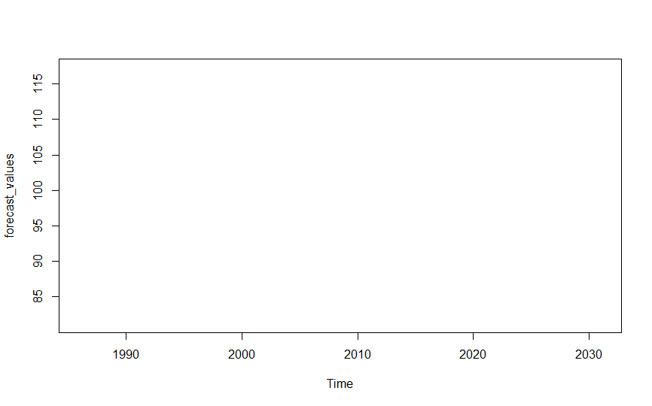
Figure : AR forecasting for RER
By using AR model forecatst of RER for next ten year is made, the forecast shows an upward trend.which implies a future possible rise of RER.

Slide 14
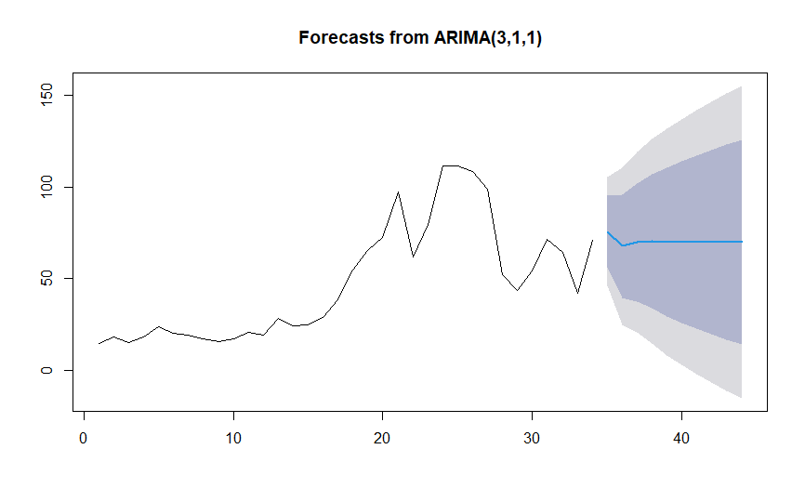
Figure : AR forecasting of COP
By using AR model forecatst of COP for next ten year is made, the forecast shows a relatively static condition of COP, which implies COP may not change that much in the up coming years

Slide 15
Conclusion
As there is clear indication that oil price shock effect economy authorities have to try to saved a portion of the money that is allocated for importing oil for the next few years.
That saved money can be invested in other priority sectors of Bangladesh’s economy like health, education, and, most importantly, the social security to improve the living standards as well as achieve overall stability during mundane time and during crisis time.

Slide 16
Limitation of the study
Data Limitations: The study relies on the availability and accuracy of data on crude oil prices and exchange rates. However, data collection methods and sources may have inherent limitations, leading to potential data errors or inconsistencies (Rafiq, 2020).
Timeframe and Sample Size: The study's findings are based on a specific timeframe and sample size, which may not capture the complete dynamics of the relationship between crude oil prices and exchange rates in Bangladesh. A longer time series or a larger sample size could provide more robust and comprehensive results (Basher et al., 2018).
External Factors: The study may not account for all external factors that influence the exchange rate, such as global economic conditions, political events, or policy changes. These factors can have significant impacts on exchange rates and may not be fully captured in the analysis (Akram et al., 2019).

Slide 17
Reference
Sosvilla-Rivero, S., & Ramos-Herrera, M. (2010). Exchange rate volatility and oil prices: The case Journal of Asian Economics, 24, 101-115.
Jammazi, R., & Aloui, C. (2015). Crude oil volatility and stock markets in the Gulf Cooperation Council countries: New evidence from nonlinear panel cointegration analysis. Energy Policy, 87, 318-331.
Ahmad, I., & Yunus, M. (2012). Oil Price and Exchange Rate: A Comparative Study on Selected Asian Countries. International Journal of Trade, Economics, and Finance, 3(3), 201-205.
Ahmed, N., Khalil, S., & Ali, Q. (2016). Relationship between Oil Prices, Exchange Rates and Stock Market in South Asian Countries: A Multivariate Analysis. Pakistan Journal of Commerce and Social Sciences, 10(3), 567-582.
Hasan, I., Shahiduzzaman, M., & Bhowmik, S. (2019). Dynamics of Oil Prices, Exchange Rates, and Stock Market: Evidence from Bangladesh. Cogent Economics & Finance, 7(1), 1625114.
Rahman, M., & Islam, M. (2017). Relationship between Crude Oil Prices, Inflation, Interest Rate, and Exchange Rate: Evidence from Bangladesh. International Journal of Economics and Financial Issues, 7(3), 221-225.

Slide 18
Thank you

